Slide 1
Introduction for employees

Slide 2
Introduction for employees
1.
Login
7.
Counters
2.
Start screen
8.
Time management
3.
My favourite apps
9.
My Documents
4.
Employee data
10.
My open tasks
5.
Dots Calendar
11.
Logout
6.
Requesting leave
12.
Do you have any questions about MyVDL?

Slide 3
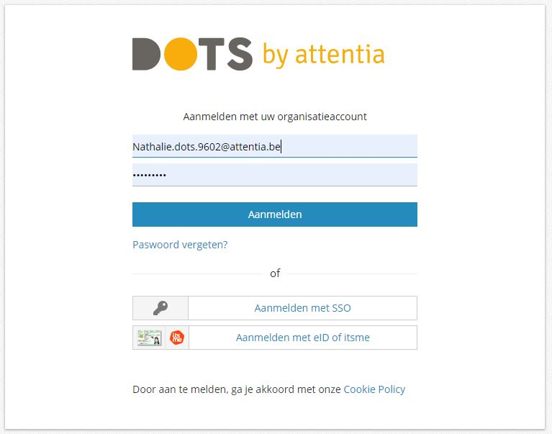
1. Login
Table of contents
https://dots.attentia.be (via Google Chrome)
Go to https://dots.attentia.be, or click on the link in www.myvdl.be. Preferably use the Google Chrome browser. You will then see the login screen.
Fill in your username and password and click on log in.
OR
Register via eID or itsme.
Do you want to protect your data properly? Then always log in using eID or itsme. You can read how this works in the instruction "Logging on and resetting your password".
Visit www.itsme.be for more information about itsme.
To use eID, you need an eID card reader and the pin code of your eID.

Slide 4
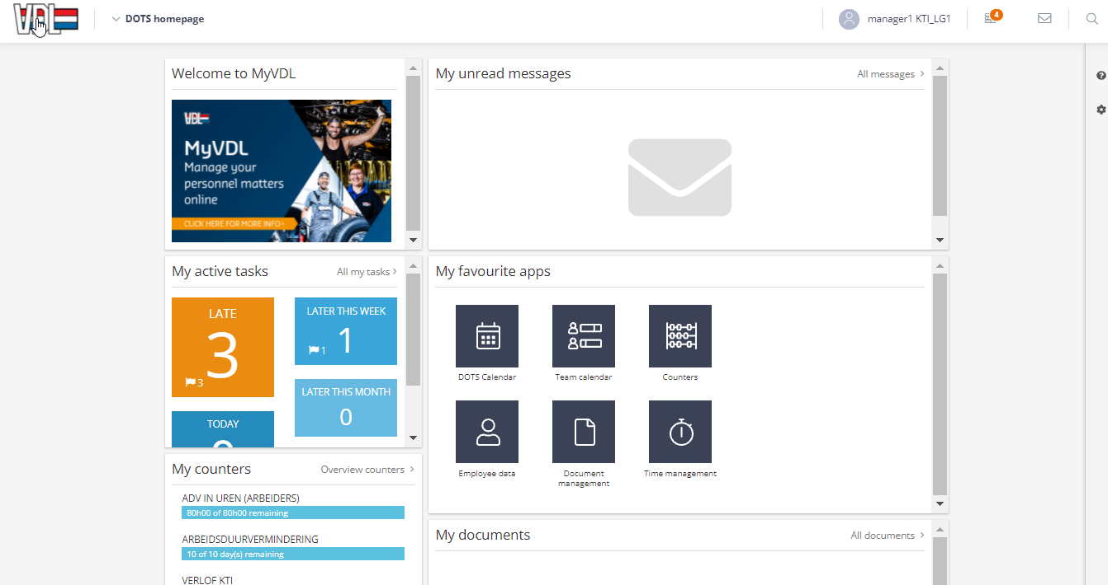
2. Home screen
Table of contents
1
2
You're logged in. You will be taken directly to the home screen.
Here you will see the following "widgets":
"Welcome to MyVDL": link to www.myvdl.be
"My active tasks."
"My unread messages"
"My counters"
"My favourite apps"
"My Documents"
The icons at the top right will take you directly to your tasks and messages.
Click on the VDL logo in the top left corner to return to the home screen.

Slide 5
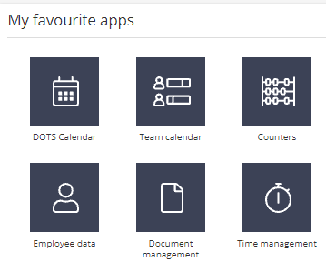
3. My favourite apps
Table of contents
Dots calendar: your own calendar
Counters: current status of your counters
Time management: calendar items and your time entries/ticks
Employee data: your personal data
Document management: all your payroll documents
In the following slides you will find more information per "app".
Team calendar: presence and absence of your colleagues. Depending on the settings for your company, you will have access to this app. For more information, please read the instruction "Leave".

Slide 6
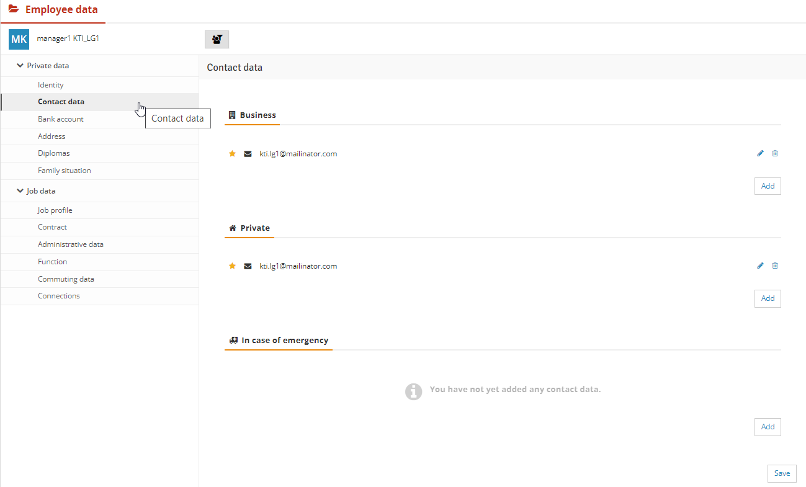
4. Employee data
Table of contents
At Employee Data you can consult your data:
Personal data and
Job Details.
You can also change a number of details, for example your "Contact data", "In case of emergency".
Click on the "pencil" to edit or "Add" if you want to add a line.
Then click on "Save".
For more information, read the instruction or frequently asked questions "Employee Data".
Click on the VDL logo in the top left corner to return to the home screen.
1
3
2
4
5
Most adjustments are sent to Human Resources for approval for further processing.
For each person both a business and a private e-mail address have been filled in. The e-mail address listed under "Business e-mail address" is your username. If your e-mail address changes, then your username will also change. You will receive a new activation e-mail.

Slide 7
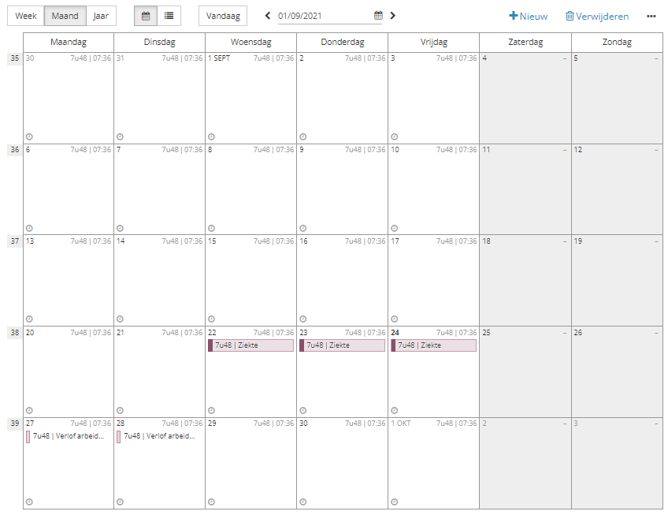
5. DOTS Calendar
Table of contents
1
In your "DOTS Calendar" you can view your calendar by week, month or year.
The number of hours to be worked per day is shown at the top right, next to it either your starting time or starting and ending time (depending on your schedule)
If you've badged, you'll see your ticks in the bottom left.
If there is a dotted line in front of the absence, it has not yet been approved by your supervisor.
2
3
4

Slide 8
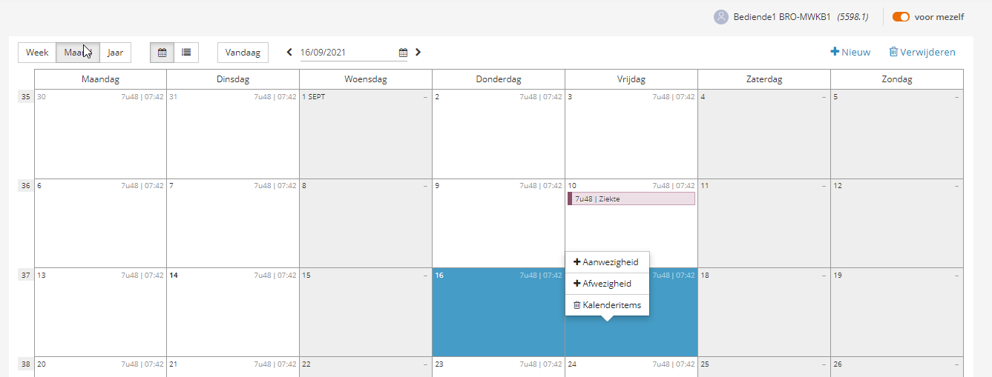
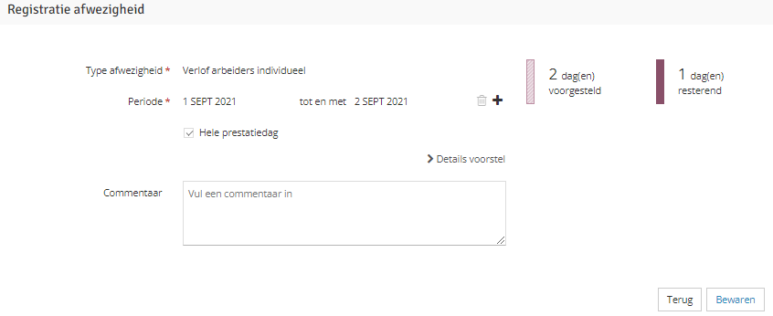
6. Requesting leave
Table of contents
2
If you wish to request a leave of absence, please select the day(s) you wish to request a leave of absence for in your DOTS calendar and click on "Absence".
OR
Click on "New".
Select which type of leave and the day(s) you want to request.
Your leave counter will be adjusted here.
After you click "Save", a notification will be sent to your supervisor.
Leave is only final once it has been approved by your manager. Always discuss your leave plans with your manager BEFOREhand, and only then register your request in MyVDL.
1
3
4
5

Slide 9
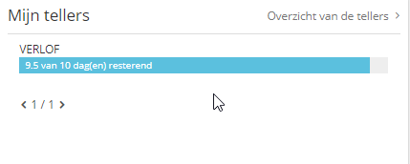
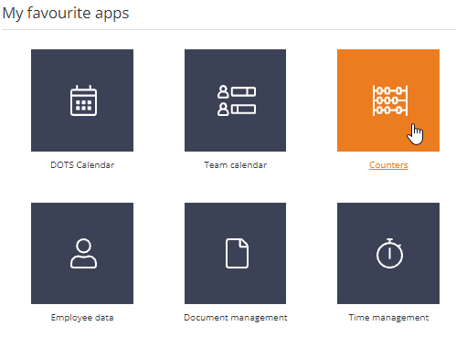
7. Counters
Table of contents
1
2
On the homepage, under "My counters" you can see the current status of your leave counters.
Want more details? Click on "Overview of the counters"
OR
Click on "Counters" under "My favourite apps".
3

Slide 10
8. Time Management
Table of contents
1
2
In time management, you can select "Calendar Items" or "Time Records" on the left.
Under "Time Records" you will see your ticks.
Under "Calendar Items" you will see a list of the absences from your calendar.
Via "New" you can also request leave.
If there is a dotted line in front of the absence, it has not yet been approved by your supervisor.
Click on the VDL logo in the top left corner to return to the home screen.
3
4
5

Slide 11
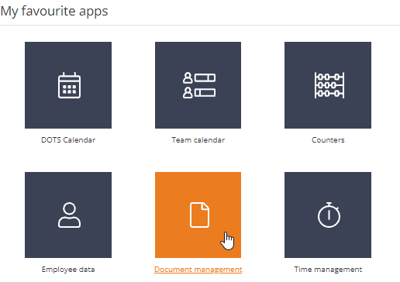
9. My Documents
Table of contents
On the home page, click on the name of the document to open it.
Do you want to consult all documents? Click on "all documents".
OR
Click on "Document Management" under "My favourite apps".
You will now see all your documents.
Click on "added" to change the order so that the most recent document is at the top.
Click here to open your paycheck or download the document.
2
1
3
3
4
5
6

Slide 12
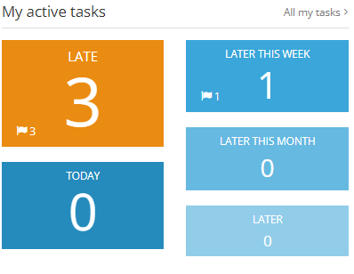
10. My open tasks
Table of contents
1
4
In the "My open tasks" widget, click on "All my tasks".
OR
Click on the tile of the tasks you want to handle (for example, "later").
Click on the task for more information or to complete your task.
And finally, "Late" here is about tasks completed late, not about "coming late" .
2
3

Slide 13
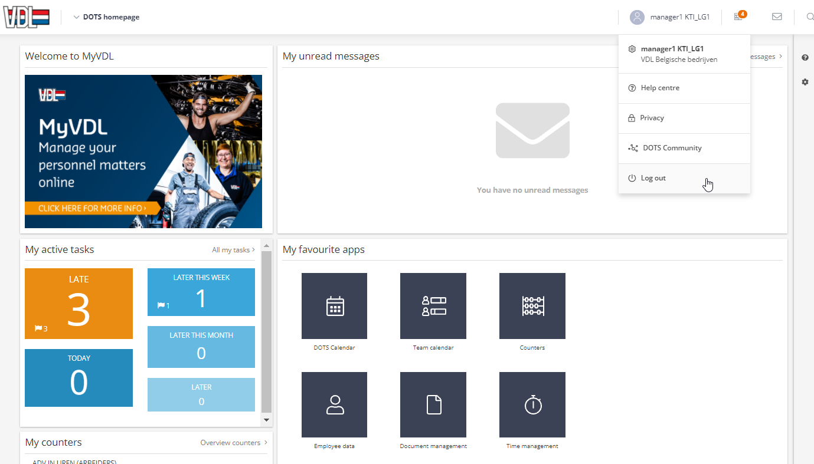
11. Logout
Table of contents
Click on your
username and
then click on
'Unsubscribe'.

Slide 14
12. Do you have any questions about MyVDL?
Table of contents
Go to the website www.myvdl.be. You will find more information in the frequently asked questions or instructions.
Ask your supervisor for help.
If you cannot find the solution, please contact the MyVDL contact point of your organisation.

